Slide 1
TOPIC: Ratios EQ: How do I Divide an Amount into a Ratio?
Year 11 Mathematics Essentials
Mrs Parlevliet

Slide 2
Things Required For This Lesson
Interactive Notebook
Textbook: Interleaved Maths Essential Connections
Ruler, Red Pen, Pencil, Pens, Scientific Calculator
Growth mindset

Slide 3
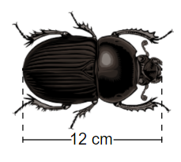
5 Questions (LHS)
What is the simplest ratio of 4:6:14?
Are 3:4 and 6:9 equivalent ratios?
Use leading digit approximation to estimate 2.7m of fabric at a cost of $4.25 per metre.
Group $35 into 7 equal parts. How much is each part worth?
The actual body length of a beetle Brad has caught is 24 mm. A scale drawing of the beetle is shown below. What distance does 1cm on the scale drawing represent?

Slide 4
VIdeo
https://www.youtube.com/watch?v=3ZoTDpK5fLo

Slide 5
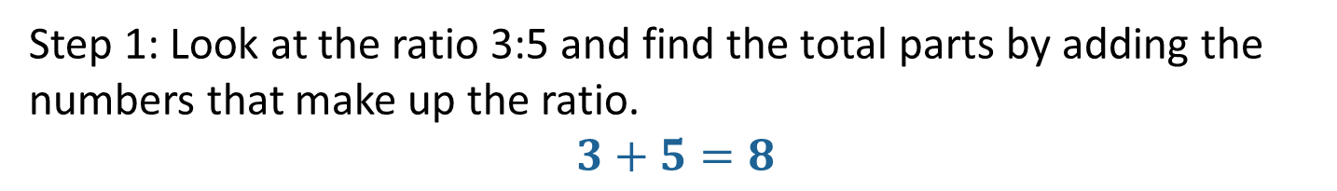
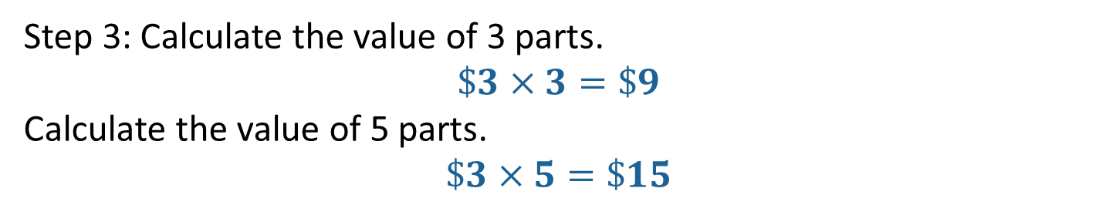
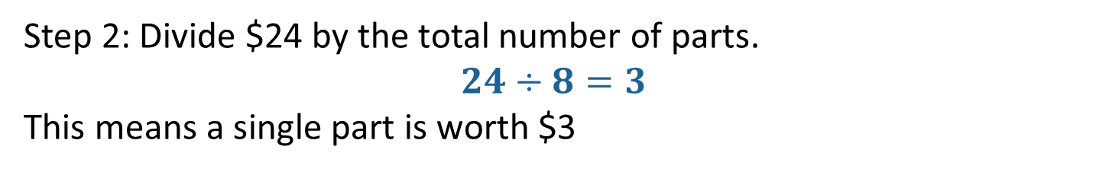
24
7
30
Ratios
Date: XX/4/2021
EQ – How do I divide an amount into a ratio?
Example: The amount of $24 needs to be divided into the ratio 3:5.
Step 1: Look at the ratio 3:5 and find the total parts by adding the numbers that make up the ratio.
$$3+5=8$$
Step 2: Divide $24 by the total number of parts.
$$24÷8=3$$
This means a single part is worth $3
Step 3: Calculate the value of 3 parts.
$$\$3×3=\$9$$
Calculate the value of 5 parts.
$$\$3×5=\$15$$
Answer: $24 divided into the ratio 3:5 is $9:$15.

Slide 6

Do you understand? Fists of Five
Notes:
Check for Understanding

Slide 7
Task
Interleaved Maths Essential Connections textbook
Complete the questions on page 33 in the sections Explore, Evaluate, and Explain
Complete Ratios of a Quantity Worksheet

Slide 8
Homework
Review your notes and write a summary answering the essential question.
Update your Contents Page

